Slide 1


ONLINE BIODATAWEBSITE
MAJOR PROJECT I
UIT RGPV BHOPAL
Submitted BY:-
RAJESH MEKCHAND
MCA 4 SEMESTER
Enrollment No.:-0101CA201022
Submitted by:-
Rajesh Mekchand

Slide 2
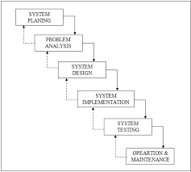
Contents
About Project
Modules in Project
Software and Hardware specification
Designing
Architecture
Model used
Implementation
Snapshots
Technologies used
Conclusion &Future Work
Bibliography

Slide 3
About project
An online resume is a digital version of your resume that includes your job history, contact information, education and relevant skills. It is not a scanned copy of your paper resume. Rather, an online resume is designed with special consideration for searchability and function.

Slide 4
MODULES IN PROJECT
MANAGE HOME PAGE.
MANAGE ABOUT ME.
MANAGE USER REGISTER.
MANAGE ADMIN LOGIN
MANAGE CONTECT ME.
MANAGE EMAIL.
MANAGE ADMIN PAGE.

Slide 5
SOFTWARE SPECIFCATION
Software requirements
Hardware requirements
Operating System | Windows (XP or above)
User Interface | HTML , CSS
Programming lang. used | Java , Java script
Framework used | BOOTSTRAP, Spring Boot
Library used | Jquery
IDE/WORKBENCH | Spring boot
Processor | PENTIUM IV or above
Hard disk | 500 GB
RAM | 4GB

Slide 6
Designing Approach
Resume Approch: Website resume is best and simple instead of pdf resume
Two motives behind making this website:
All types of users of this website, non-professional and professional people can do it..
Website is the easiest and best way. If you give in your paper! Paperless resume looks more effective. Any person will be in direct contact with you.
.

Slide 7
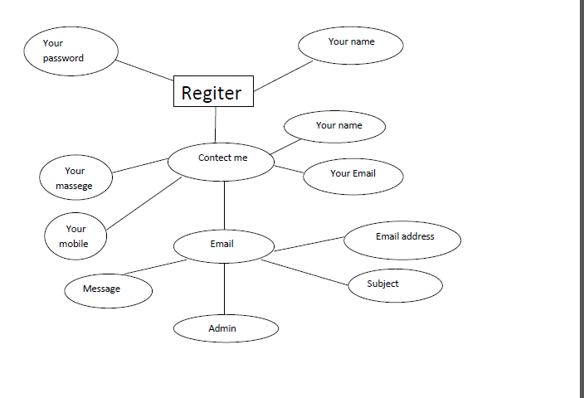
ONLINE BIODATA E-R DAIGRAM

Slide 8
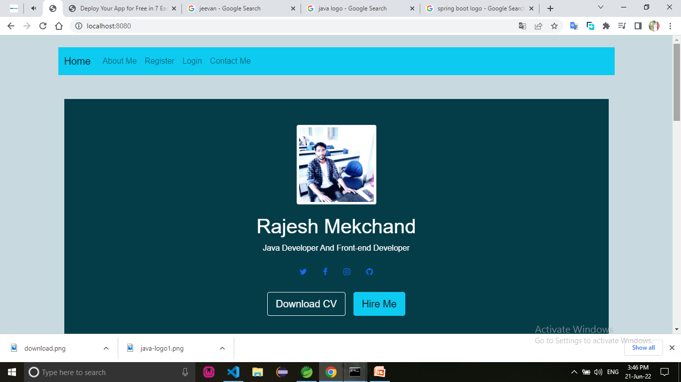
Implementations
Snapshots

Slide 9
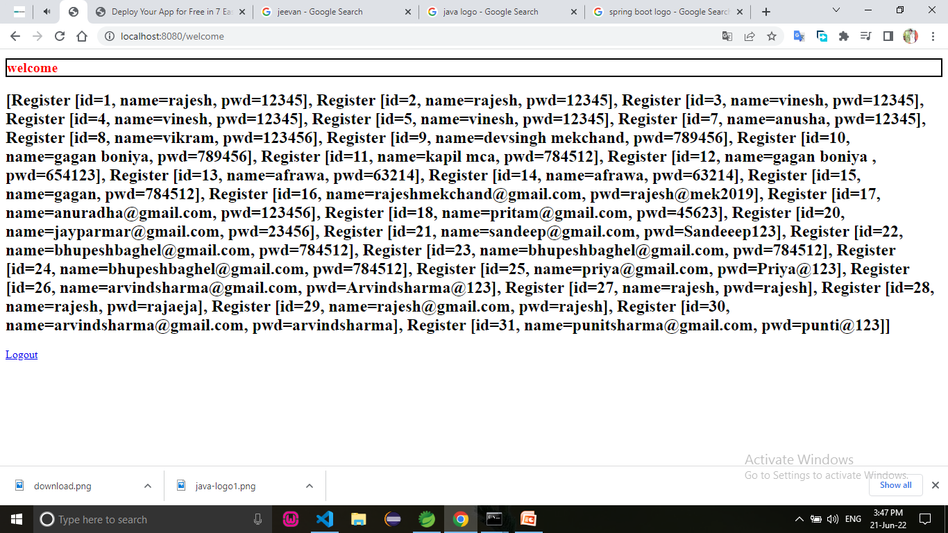
User details

Slide 10
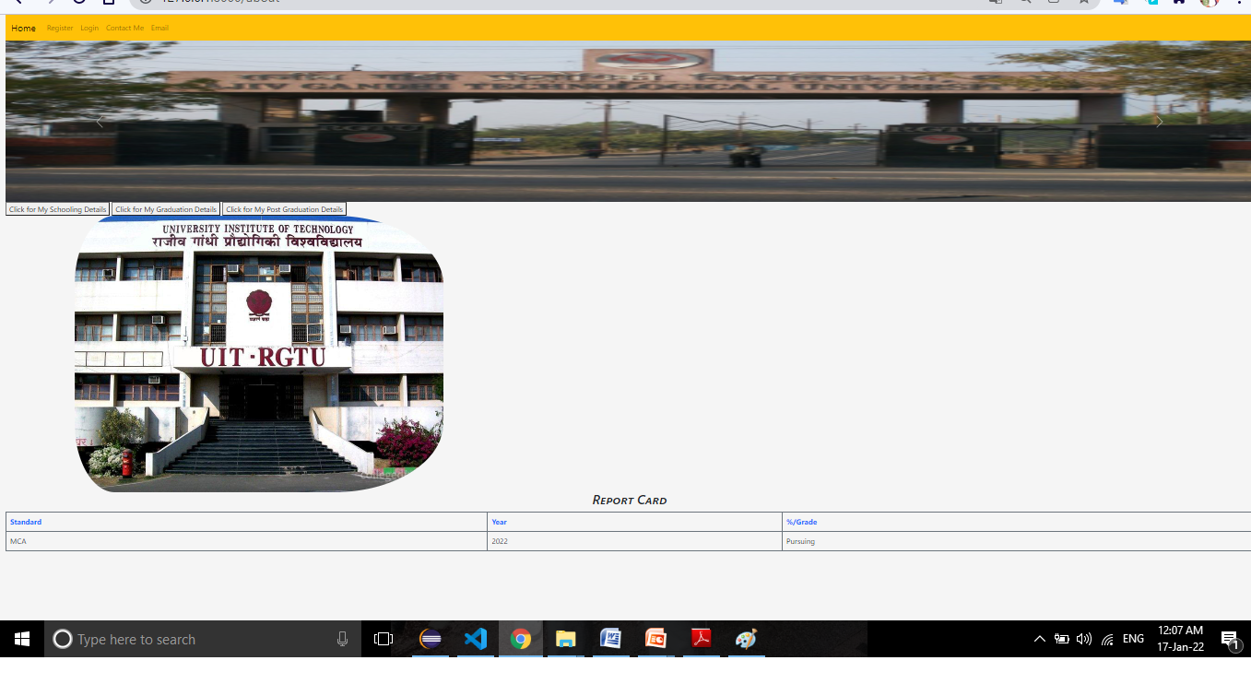

Slide 11
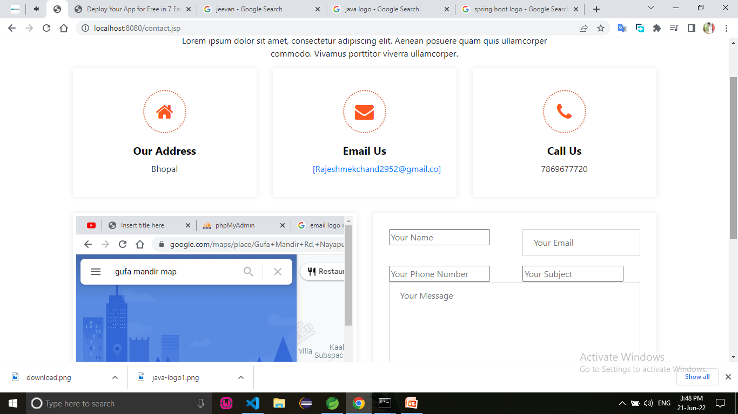

Slide 12
Conclusion and Future work
The new form of Resume is made in the style to show your Resume on the new look, here is the form of profile of social media Facebook, Instagram. Based on the same, it has been told in a new form.
With the increasing expansion of technology, resumes and resumes also want to be seen as a website. Paper Resume, Resume in PDF can be roaming anywhere. There can be many problems. Along with this website profile, many new features have also been added. Can email you directly, visit your social media and see you. Reliable information can be found. Further, you can add the option of online chat and our personal information in this.

Slide 13

BIBLIOGRAPHY
www..org
www.developer.mozilla.org
www.getbootstrap.com
www.javascript.com
www.youtube.com

